Slide 1
PathFinder – A website compiling various colleges pathways
Anthony Sy (VC1A)
ANTHONY.SY50@bcmail.cuny.edu
Supervisor: Minh Le, MINH.LE@brooklyn.cuny.edu

Slide 2
Abstract
When entering a college, you can look at their official website to find information about their various pathways. For this project, I aim to compile all this information into one condensed database & website.
Completion of this project requires designing a user friendly & intuitive website, along with a working database connection.
The goal for this website is to create a single website where you can search for any desired college/university and find some that you might not even heard of, allowing the user to expand their choices.

Slide 3
Use Case
The user will come into the page with the intent of looking at various colleges/universities.
They will search by county to find all their local schools OR by searching a school directly.
After selecting a school, they are brought to a page with their respective given pathways
This gives them the option to select which one they are interested in.
After clicking on the pathway they want, it will send them to a popup.
The popup will have an embedded image of the pathway as well as a directory to the original location of the information.

Slide 4
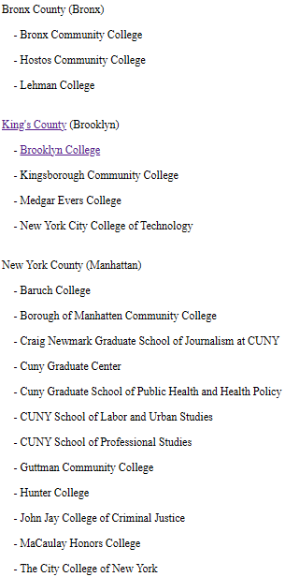
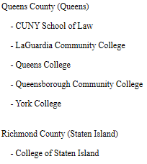
Down scaling of the project
Originally this project was aimed to encompass all counties around the states and compiling all their respective colleges & universities.
However, due to time constraint & not enough prior knowledge. The scope has severely tunneled into CUNYs specifically.
This does not mean that the scope will remain static. As I progress through deeper into the project, the scope will slowly expand.

Slide 5
Swapping from MySQL to SQLite
SQLite is integrated within Django allowing for easier access.
Ideal for smaller applications and local storage
Self-contained and requires no separate server process, thus easier to deploy
MySQL is designed for larger-scale applications and transactional processing which I do not need
Requires a separate server thus needing more work to get it going

Slide 6
Desired user engagement
With such a compilation of pathways and courses, you would want to suggestions, advice or guidance on said selection.
I plan to add a user engaged comment & suggestion section where they can post their own opinions, thoughts, likes, dislikes, etc, that can be freely viewed by others.
However, this implementation is aimed to be an afterthought as it is something that can only be implemented after the website is finished. Thus, it will most likely not be added within the semester.

Slide 7
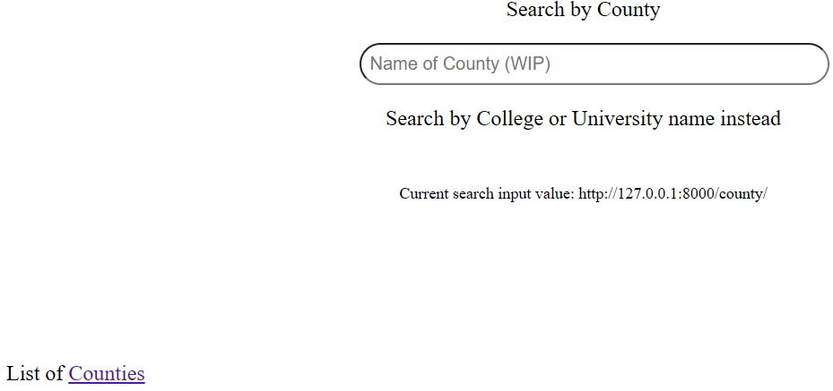
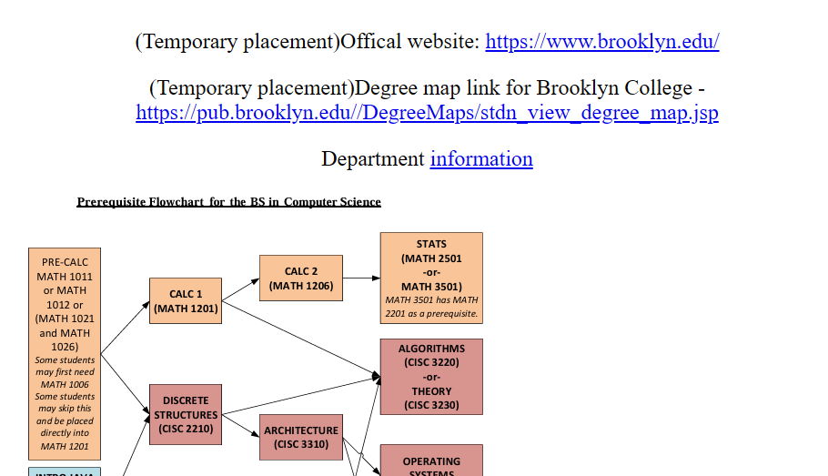
Website Interface
This is the base design of the website.
The initial page will have a search bar that allows the user to either search by county, or school name
When a school has been selected, it will show the pathways listed by Majors and Minors. When one is selected, it will show you all of the relevant information of that pathway.

Slide 8
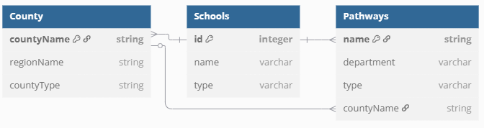
Database Schema
The expected schema structure of the database. It will contain multiple instances of schools as that is the college/universities class. The main page, will be able to connect directly to both Counties and Schools.
One County can have multiple Schools, but one School belongs to one County.

Slide 9
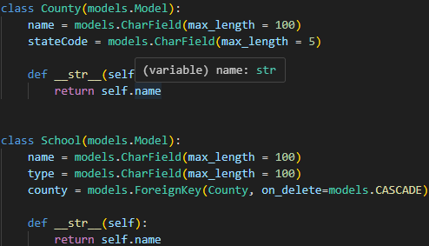
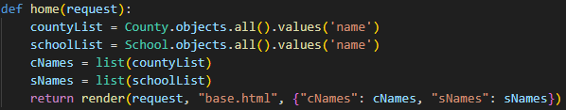
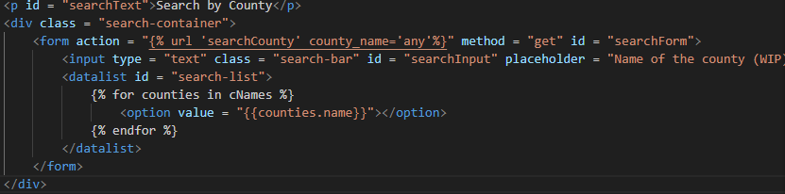
MVT – Model View Template
This is what Django uses to host and display the development server within the framework.
In your Model(models.py) you define your table/data structure
Then in View(views.py) you retrieve the data and pass it onto a template
Run the development server by cmd command: “python manage.py runserver”
Then onto the Template(xxx.html) you can display the data.

Slide 10
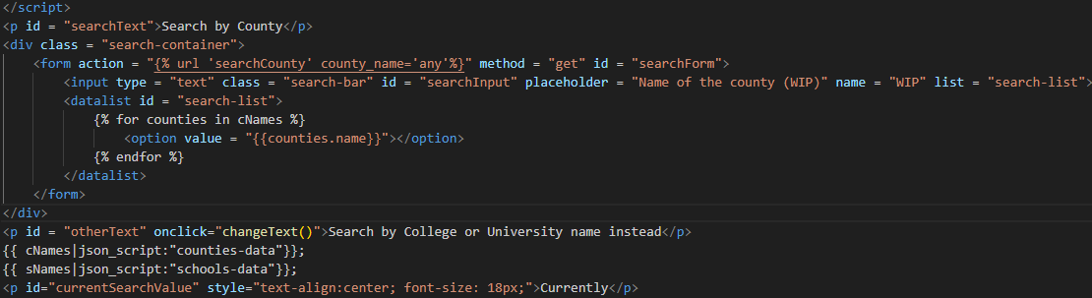
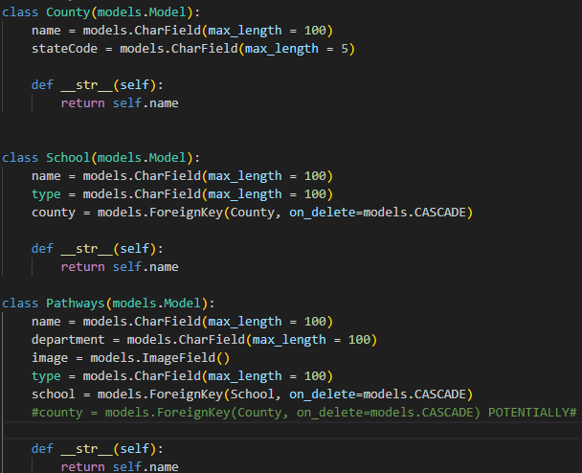
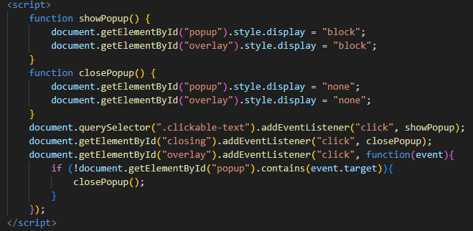
Code Snippets
Database
HTML

Slide 11
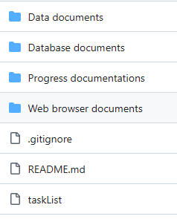
Folder layout
Data documents holds my Scrapy project
Database Documents holds my Django framework project
Progress documentations holds this powerpoint & my time logs
Web browser documents hold my pure HTMLs

Slide 12
Data sources used so far
CUNYs
Brooklyn College
KingsBorough Community College
Baruch College
….
As of submitting this final PowerPoint, I’ve only used Brooklyn College

Slide 13
Tools used for project
IDE for website creation – Visual Studio Code
Using Tailwind extension library
DB framework – Django
Using SQLite
Data scraper - Scrapy
Microsoft Excel
Used for holding data
Note: These tools are subjected to change

Slide 14
Github CUNY Api
I found this Api on GitHub that allowed you login to CUNY first, allowing you to grab information
However, it only lets you grab data relevant to your own account, such as your own schedule, courses, grades, etc. but not anything else outside of your account scope.
This was a very interesting Api to discover and us. It gave me an opportunity to learn how to integrate an Api into Django but since it couldn’t access beyond personal data, it became wasted time.

Slide 15
References used for this project
Tech with Tim
HTML, CSS & JScript
Tailwind library
Inspiration/Ideas to use in Django
Django tutorial
SQLite integration
And other mentions within my time log

Slide 16
Biggest obstacles experienced in the project
Throughout the project, I am relearning HTML as I learned it in High School. Thus, I am coding along as I go. However, despite learning about both HTML and databases separately, I didn’t learn how to integrate databases into anything, causing me to be stumped which let me to the Django framework.
It uses python which I never learned before, so it was an extra step in difficulty.
I’ve had a lot of help from my supervisor as he gave me a lot of usage examples of backend, which includes
Django
FastAPI
Flask
Although he has given me a lot of help throughout the whole project, it is up to me be able to read, learn, and understand the language, Api, framework usages, etc.

Slide 17
CISC 3171
This class that I am currently taking, is focused on the development of android applications. However, in the process of learning it, it has taught my SMART, MVP, User Stories, etc, allowing me to create objectives and organize them easier as well.
As a user,
I want to search my local colleges,
So that I can go to their websites within 5 minutes.
S – Allowing the user to search through the schools in their area
M – The user can go to their wanted school’s website within 5 minutes
A – This can be completed in an agile iteration
R – Allowing the user to see all their local schools
T – To be completed by end of May 2025

Slide 18
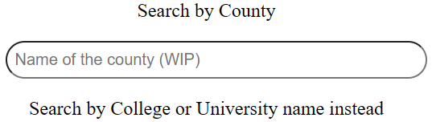
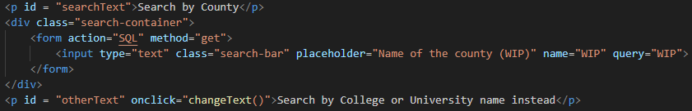
CISC 3810
This class taught database, in the form of Oracle. This is going to help me develop my back-end for my own website, which will use SQL, as they both have similar syntax language.
I aim to use this database as a query, allowing the user to search for their wanted county, college or university.
As of 3/27, I am currently researching on how to connect the database into the html.

Slide 19
Planned Progression Schedule
As of updating this PowerPoint, it is week 15, 5/11/25
Week 4-8
Relearn HTML, CSS. Create base website & learn JavaScript
Week 8-11
Create database & connect it with website, bell and whistles
Week 12-14
Post project on public threads, get user reactions & comments.(Potentially)
Data Scrap for scoped information. (Priority)
Week 14-15
Final bug fixes & adjustments
Final Submission on 5/12
Schedule is subjected to change as progression happens

Slide 20
Weeks 1-3
Beginning of the semester
Discussed with my friend who was also taking 4900 if he wanted to do the project with me
Took two weeks, (week 2) to finalize our decision.
Ended up doing the project solo -> wanted to do website building with a Database and use data scraping for the Database
Found a supervisor, Minh Le, a CISC professor.

Slide 21
Weeks 4-8
Since building a website requires HTML, CSS, JScript, I needed to relearn some of the basics (week 4)
Created my expected layout design for website, how each webpage connects with each other, etc.
Created initial Diagram, showed & discussed with my supervisor (week 5)
Learning CSS & Jscript as I code (week 6-8)

Slide 22
Weeks 8-11
I started reading into how to create a proper Database.
Initially I wanted to just create it using MySQL since that is what I am familiar with due to CISC 3810
Asked my supervisor for advice and he suggested to use a framework instead such as Django, Flask, etc.
Did more research and chose Django due to him being part of the actual creation of Django
Looked into connecting the HTML to Django to MySQL but discovered Django has its own DB, SQLite, thus I swapped.
Created popup instead of new HTML for every pathway.

Slide 23
Weeks 12-14
Week 12 was spring break, I decided to take a break from the project and focus on my other course projects instead.
Week 13 I resumed my project, updated my project management with the assignment. After I started using the Django framework
Created Models, views, templates
Week 14 I delved into data scraping and finalized on using Scrapy as the tool since it uses python as well, same as Django so it is less research/learning required.

Slide 24
Weeks 14-15
Week 14 – Research on how data scraping actually worked. Tried it on my own, some success, but mostly failure.
Other research on how to mass input scrape data into SQLite table
Week 15 – Last week, submission on 5/12. Created some tables using my models.py data structure using scraped data. Tested it using MVT. Implemented a suggestion feature within search bar, search bar actually works now -> brings you to correct html
End of time for project. I want to continue it after my final ends.
(I thought we would have 16 weeks in total including spring break so now week values doesn’t match up with days in time logs)

Slide 25
Time well spent?
Overall the time I dedicated towards the project, although a bit low, even for my standards, due to other courses, was very insightful.
I relearned HTML, CSS. Learned Java Script
I learned Python to learn how to use the Django framework.
Relearned a bit of SQL language and used it in SQLite
Learned how to use scrapy (at a low level)
Learned how to do Version Control (throughout the semester)
Wished I had more time so I could make more progress on the project

Slide 26
Future Projects
I think the scale of what I was aiming for was doable if I already had the knowledge of everything beforehand
I should dedicate more research into tools rather than design plannings and layout planning
As a solo project, I need more time to explore everything and need someone to help give suggestions such as Django or Tailwind due to not knowing anything
I can see why everyone uses a web builder for modern sites now
If someone were to do something similar to what I did, I would tell them to either dedicate maybe double my time or use a web builder

Slide 27
Development over Production
On a technical point, I can push it into production since it has a MVP, minimum viable product. It can look counties, only one is working, King’s County, into Brooklyn College, look at Computer Science.
However, for the project itself, it is not good enough thus it hasn’t been pushed to the public threads as wanted for week 12-14.
The upside for keeping it in development I am still allowed to experiment it and pretend that I am an end user, thus allowing my expectations to be met.
The downside of not having it in production is that I can’t get other people’s opinions on the design interface which is just bells & whistles.

Slide 28
Future enhancement/continuation
Want to continue this project even after the semester is over
Create a user login form for comment posting
Fully fleshed out tables instead of one sample
Expanding scope after bell & whistles

Slide 29
Goals Achieved & Failed
Achieved being able to make HTMLs
Creating and linking a DB via Django
Partially dipped into data scraping
Failed to make a fully fleshed out Website
Failed to make web design properly
Failed to mass import scraped data into DB

Slide 30
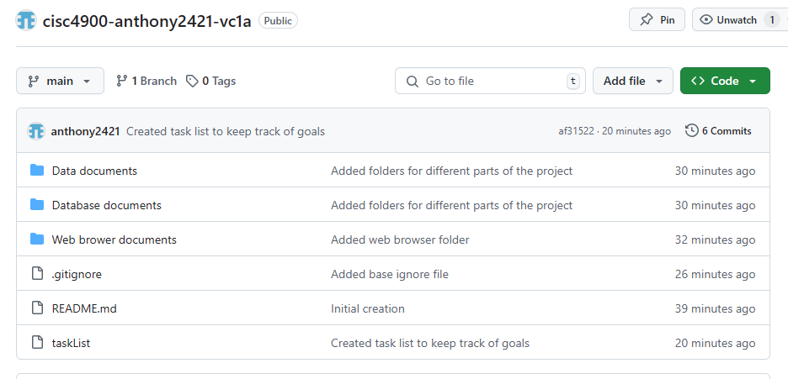
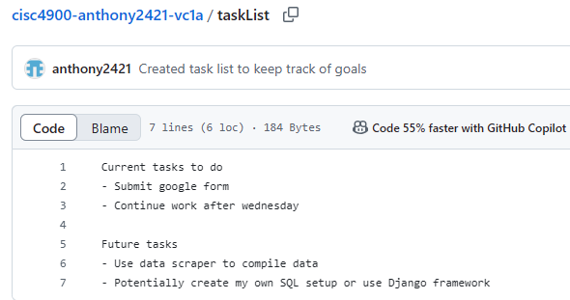
GitHub Repository
Original Repository
https://github.com/anthony2421?tab=repositories
Project Management
cisc4900-anthony2421-vc1a/taskList at main · anthony2421/cisc4900-anthony2421-vc1a

